Slide 1

Marino Center
December 2
Community Learning Session
TEAM MEMBERS
Leonid Gordin, MD – Holistic Medicine
Lucille Shore-Schein, MD – Rheumatology
Carleen Mellon – Lead Admin Assistant
Guerline Maingrette – Admin Assistant
Elaine Kerrigan – Practice Manager
Marguerite Herrie – Practice Director / Coach

Slide 2
What did we work on?
What did we try to “fix”?
Worked on increasing patients’ understanding directions on specialty tests.
  Tests were being delayed due to misunderstandings in the process, missing information on order forms, uncertainty in shipping process.
We wanted to be sure that when patients left with their kits all concerns were addressed.

Slide 3
What did we measure?
How could we tell if a change worked?
We measured:
  Time spent explaining specialty kit directions
  Time spent answering questions by phone
  Time kits were returned and processed
Improvement would see decrease in all 3

Slide 4
Example of changes that we tested
3 groups tested 3 approaches.
  1. ) Patients who sat with staff, had all questions answered
  2.) Patients who met with phlebotomist, had some questions answered
  3.) Patients who picked up test kit without speaking with staff

Slide 5
Process Changes
Our study made it clear we needed a process change. Our challenge was designating staff to meet with the patient for 15 – 20 minutes. We also needed to educate staff on the nuances of the specialty tests so patient questions could be answered.
What’s in the works? - Moving toward Adoption of Changes

Slide 6
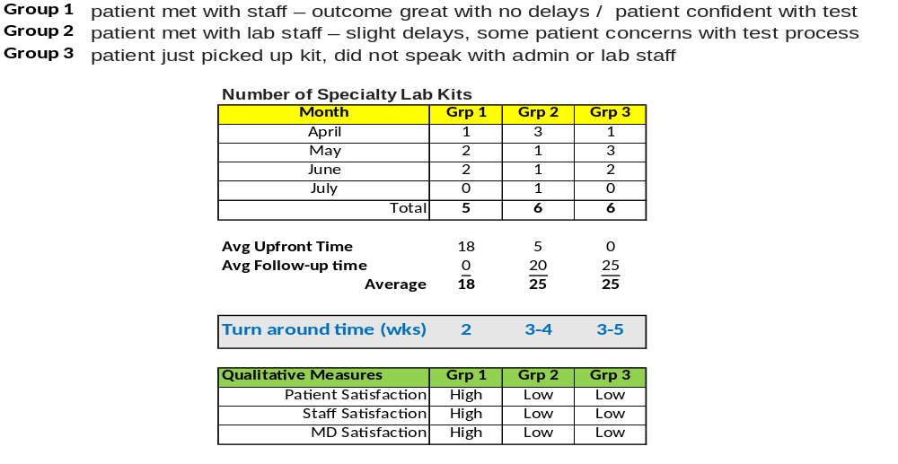
What were the results?
Notes:
Add Elaine’s slide with data from October 21.

Slide 7
What did we learn?
We learned that it is imperative to meet with the patient for the best outcome.
Our challenge is dedicating staff to be available and making sure we capture the patient prior to them leaving with their kit.
It is optimal to do instructions face to face rather than over the phone.

Slide 8
What we will keep doing
Our bright spot in the project was seeing the positive outcome when we met with patients. It was clear we needed to meet with as many patients as possible. Patients were happy, staff was happy as it decreased phone calls and complaints.
Our goal is to develop the habit (create a safe culture) for partnering with our patients through soliciting feedback and asking open-ended questions.

